Slide 1
Pre-read
https://tdwi.org/articles/2016/07/25/graph-databases-for-analytics-1.aspx
Social network analysis http://www.orgnet.com/sna.html
https://www.infoworld.com/article/2877489/big-data/how-graph-analytics-delivers-deeper-understanding-of-complex-data.html
https://www.crowdchat.net/getgraph
https://www.ibmbigdatahub.com/blog/what-graph-analytics
https://www.cray.com/blog/graph-databases-101/

Slide 2
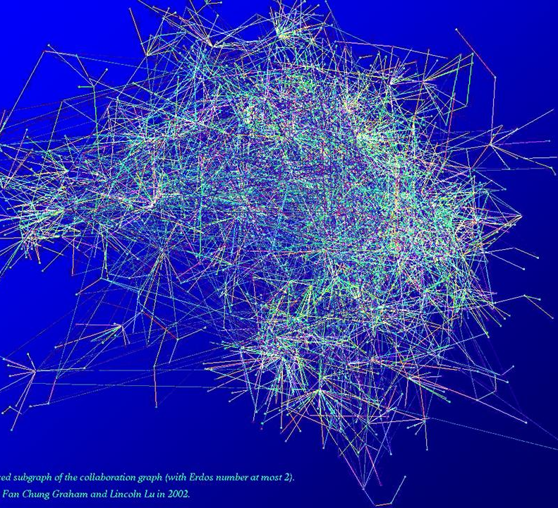
Tables, Graphs, and Property Graphs
Source:
https://www.math.ucsd.edu/~fan/complex/
Notes:
http://www.datasciencecourse.org/notes/graphs/graphs.pdf

Slide 3
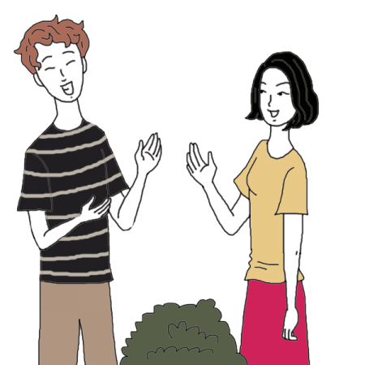
Activity: Find a person you haven't talked to recently
Discuss the homework assignment of testing how file I/O scales
Notes:
https://www.auntyflo.com/dream-dictionary/neighbor

Slide 4
Demo
Ben shows completed homework
cd Desktop/UMBC_DATA601/homework/homework_week11
docker run -p 8888:8888 --net=dockernet -v "$PWD":/home/jovyan datasci

Slide 5

Course schedule and outline (scope)
Oct 25: Automation, Reports
Nov 1: Scaling up, Estimation
Nov 8: Cost/benefit
Nov 15: No class due to weather
Nov 22: No class (Thanksgiving)
Nov 29: Property graphs
Dec 6: Ethics; Docker, Elasticity
Dec 13: Presentations
Aug 30: Overview Data Science
Sept 6: Python in Jupyter
Sept 13: Math (stats)
Sept 20: Regression
Sept 27: Clustering
Oct 4: Getting data
Oct 11: Substitute's choice
Oct 18: Data cleanup

Slide 6
With two classes remaining, tell me what you want to know more about
For example,
Basic visualization use in Python
https://jakevdp.github.io/PythonDataScienceHandbook/04.01-simple-line-plots.html
Gallery of what's possible
https://matplotlib.org/gallery.html
Fancy visualizations
https://www.makeovermonday.co.uk/makeovers/

Slide 7
Projects schedule
Aug 30:
Sept 6:
Sept 13:
Sept 20:
Sept 27: preview
Oct 4: start proposal for mid-term
Oct 11: Submit proposal for mid-term project
Oct 18: Start mid-term project
Oct 25: reminder to check-in
Nov 1: Submit mid-term project; start proposal for final
Nov 8: Submit proposal for final
Nov 15: Final project assigned
Nov 22: No class (Thanksgiving)
Nov 29: reminder to check-in
Dec 6: Final project due
Dec 13: Presentations

Slide 8
Opportunity for Early presentation (max 3)
Next class (Nov 29) I will ask if anyone wants to present early (Dec 6)

Slide 9

Anonymous question
"Can you show us an example of
how to create a cost-benefit analysis in Python?"

Slide 10

How the exercise fits into my experience
What is the question that decision makers are faced with?
Create a model (costs, benefits, risks) using context (history)
Identify which variables are quantifiable (costs, money, time)
Chase the relevant data
Analyze (occasionally requires Python)
Present analysis and results to decision makers
In-person
Using Excel, Powerpoint

Slide 11

How the exercise fits into my experience
What is the question that decision makers are faced with?
Create a model (costs, benefits, risks) using context (history)
Identify which variables are quantifiable (costs, money, time)
Chase the relevant data
Analyze (occasionally requires Python)
Present analysis and results to decision makers
In-person
Using Excel, Powerpoint
(We did this in class last week)

Slide 12

How the exercise fits into my experience
What is the question that decision makers are faced with?
Create a model (costs, benefits, risks) using context (history)
Identify which variables are quantifiable (costs, money, time)
Chase the relevant data
Analyze (occasionally requires Python)
Present analysis and results to decision makers
In-person
Using Excel, Powerpoint
This takes time, from minutes to years

Slide 13
How the exercise fits into my experience
Because you're asking a novel question,
There may not be a policy that governs collection of that data
Policy may exist, but it may not cover the case you are interested in
The source of the data may be unknown
Data may exist, but it could be unreliable. Validation is needed.
The data owners may not be known. You may need to develop a relationship
Data collection may need to be initiated. Collection infrastructure may need to be created
What is the question that decision makers are faced with?
Create a model (costs, benefits, risks) using context (history)
Identify which variables are quantifiable (costs, money, time)
Chase the relevant data
Analyze (occasionally requires Python)
Present analysis and results to decision makers
In-person
Using Excel, Powerpoint
This takes time, from minutes to years

Slide 14
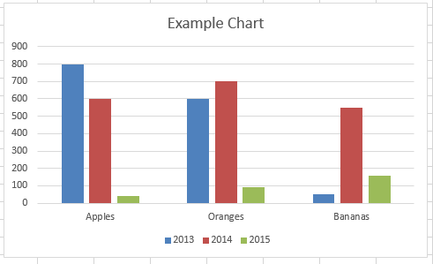
How the exercise fits into my experience
What is the question that decision makers are faced with?
Create a model (costs, benefits, risks) using context (history)
Identify which variables are quantifiable (costs, money, time)
Chase the relevant data
Analyze (occasionally requires Python)
Present analysis and results to decision makers
Deliver in-person
Deliver using Excel, Powerpoint

Slide 15
Decision usually implies finding a Break even point using Cost-benefit analysis
When comparing outcomes, durations and lifespans matters
"cost" is usually per item produced
Rate of item production is a variable

Slide 16
hire additional staff
Benefits:
Expand work capacity
Costs:
Onboarding (training, getting accounts)
Risks:
New employees underperform
pay overtime wages
Benefits:
Staff is already trained
Costs:
Higher cost than normal hourly wage
Risks:
Burn out of existing staff
More data needed:
Stakeholders
What's the relevant timeline?
What's the durability of the activity?
Can our business survive without this component?
Quantify each aspect

Slide 17
Demo:
http://127.0.0.1:8888/notebooks/week12_property_graph/cost-benefit_break_even_point_for_labor.ipynb
Compare to Excel spreadsheet

Slide 18
Common trade-offs to be evaluated
short-term vs long-term
Short-term activities may be riskier, cost more, yield quicker results, enable flexibility
Long-term activities may be lower risk, yield better cost per widget
local versus wide-spread
Local = easy to control, low cost to implement, low impact, outcomes may be specific to locality
Wide-spread has communication costs, enables consistency, allows detection of outliers

Slide 19
Decision trope: autonomy vs orchestration
Autonomy
Artisian products and services
Competition for resources among providers
Friction associated with repetitive negotiation and acquisition
Finding prices, identifying stakeholders, determining timelines
Orchestrated
Benefits of scale
Potentially more efficient use of resources (materials, time)
Relies on participants haveing shared objectives

Slide 20
Examples of autonomy vs orchestration
Everyone drive their own car, or have self-driving cars
One IT support desk per organization, or a centralized IT support desk
Government versus anarchy
Exercise at home versus exercise at a gym

Slide 21
Costs, Benefits, and Risks of data science
Brainstorming activity
Step 1: Count off by 1,2,3,4,5,1,2,3,4,5,1,2,3,4,5
Step 2: In groups of 3, write down
At least 3 costs of data science
At least 3 benefits of data science
At least 3 risks associated with doing data science

Slide 22
Costs, Benefits, and Risks of data science
Step 1: Count off by 1,2,3,4,5,1,2,3,4,5,1,2,3,4,5
Step 2: In groups of 3, write down
At least 3 costs of data science
At least 3 benefits of data science
At least 3 risks associated with doing data science
Step 3: you aggregate answers on the whiteboard

Slide 23
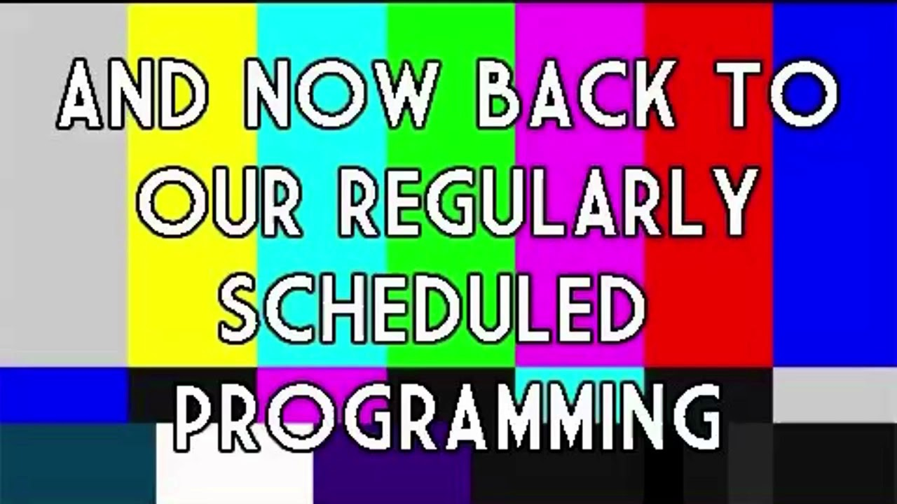

Slide 24
By the end of this session,
You should be able to
Explain when to use a list, table, and graph
Describe the advantages of using graph data structures
Create a visualization of a graph
Show how to query information stored in a graph

Slide 25

Introduction to graphs
Addressing points from week 11
Introduction to Graphs

Slide 26

Data Structures covered in Data 601
Scalars (int, float):
4
524.52
-934
Strings:
"ben"
"data 601"
Lists:
["ben", 4, -934, "data 601"]
Tuples:
("ben", "bob")
(3, 4, 9)
Dictionaries:
{"instructor":"ben", "number of cats": 4, (3,4,9): -934, "class":"data 601}
Tables (CSV, Pandas, SQL, Excel) with rows and columns

Slide 27
Table 1 describing relations among entities
Person | Knows | Duration in years
Bob | Anna | 1
Bob | Kate | 4
Bob | James | 2
Anna | Kate | 4
Max | Jim | 1
Kate | Jim | 8
Angela | Anna | 2

Slide 28
Table 2 describing relations among entities
Company | Person | Position | Friend count
Pepsi | Bob | Delivery | 142
Acme | Kate | Sales | 47
Heavy Industry Inc. | Bob | Research | 124
FunTymes | Anna | Coordinator | 634
Roboflex | Max | Manager | 152
HR Support | Kate | Tester | 89
UMBC | Angela | Data Scientist | 252

Slide 29
Graph: nodes and edges
A
H
J
B
G
Node = vertex = an entity
Edge = link = a relation or connection between entities
C
K
F
D
E
Nodes: A, B, C, D, E, F, H, J, K, G, M
M
Edges: (A,B), (C,G), (C,E), (D,H), (E,K), (F,M), (H,G), (J,K), (G,K)
Caveat: this graph is unrelated to the tables in the previous slide

Slide 30
Conventional distinction
Networks are the systems of interrelated objects (in the real world)
Graphs are the mathematical model for representing networks
source

Slide 31
Relation between graph and adjacency matrix
A
H
 | A | B | C | D | E | F | G | H | J | K | M
A | 0 | 1 | 0 | 0 | 0 | 0 | 0 | 0 | 0 | 0 | 0
B | 1 | 0 | 0 | 0 | 0 | 0 | 0 | 0 | 0 | 0 | 0
C | 0 | 0 | 0 | 0 | 1 | 0 | 1 | 0 | 0 | 0 | 0
D | 0 | 0 | 0 | 0 | 0 | 0 | 0 | 1 | 0 | 0 | 0
E | 0 | 0 | 1 | 0 | 0 | 0 | 0 | 0 | 0 | 1 | 0
F | 0 | 0 | 0 | 0 | 0 | 0 | 0 | 0 | 0 | 0 | 1
G | 0 | 0 | 1 | 0 | 0 | 0 | 0 | 1 | 0 | 1 | 0
H | 0 | 0 | 0 | 1 | 0 | 0 | 1 | 0 | 0 | 0 | 0
J | 0 | 0 | 0 | 0 | 0 | 0 | 0 | 0 | 0 | 1 | 0
K | 0 | 0 | 0 | 0 | 1 | 0 | 1 | 0 | 1 | 0 | 0
M | 0 | 0 | 0 | 0 | 0 | 1 | 0 | 0 | 0 | 0 | 0
J
B
G
C
K
F
0 = no connection
1 = edge exists
D
E
M
Nodes: A, B, C, D, E, F, H, J, K, G, M
Edges: (A,B), (C,G), (C,E), (D,H), (E,K), (F,M), (H,G), (J,K), (G,K)
Number of entries with "1" is double the number of edges

Slide 32
Matrix for Undirected graph has diagonal symmetry
A
H
 | A | B | C | D | E | F | G | H | J | K | M
A | 0 | 1 | 0 | 0 | 0 | 0 | 0 | 0 | 0 | 0 | 0
B | 1 | 0 | 0 | 0 | 0 | 0 | 0 | 0 | 0 | 0 | 0
C | 0 | 0 | 0 | 0 | 1 | 0 | 1 | 0 | 0 | 0 | 0
D | 0 | 0 | 0 | 0 | 0 | 0 | 0 | 1 | 0 | 0 | 0
E | 0 | 0 | 1 | 0 | 0 | 0 | 0 | 0 | 0 | 1 | 0
F | 0 | 0 | 0 | 0 | 0 | 0 | 0 | 0 | 0 | 0 | 1
G | 0 | 0 | 1 | 0 | 0 | 0 | 0 | 1 | 0 | 1 | 0
H | 0 | 0 | 0 | 1 | 0 | 0 | 1 | 0 | 0 | 0 | 0
J | 0 | 0 | 0 | 0 | 0 | 0 | 0 | 0 | 0 | 1 | 0
K | 0 | 0 | 0 | 0 | 1 | 0 | 1 | 0 | 1 | 0 | 0
M | 0 | 0 | 0 | 0 | 0 | 1 | 0 | 0 | 0 | 0 | 0
J
B
G
C
K
F
D
E
M
Nodes: A, B, C, D, E, F, H, J, K, G, M
Edges: (A,B), (C,G), (C,E), (D,H), (E,K), (F,M), (H,G), (J,K), (G,K)
Number of entries with "1" is double the number of edges

Slide 33
Difference between graph, plot, chart, figure?

Slide 34
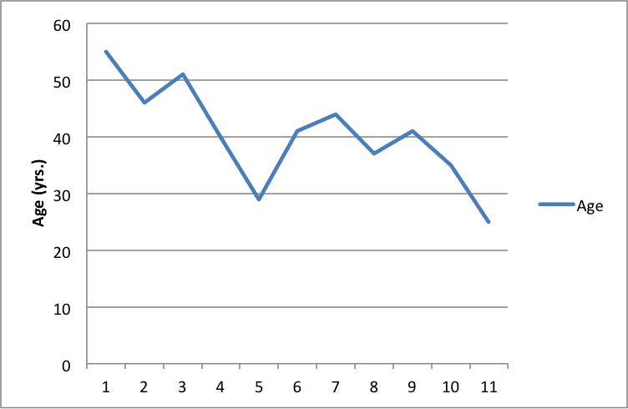

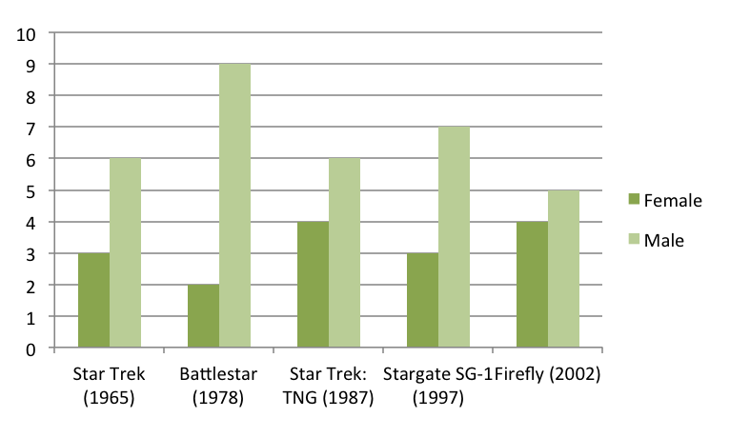
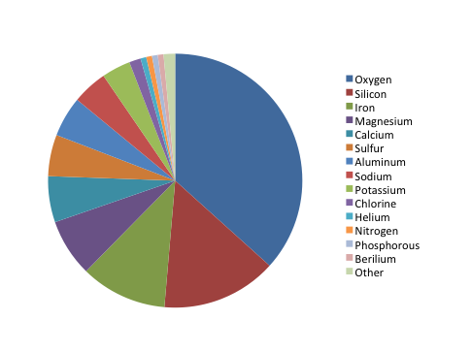
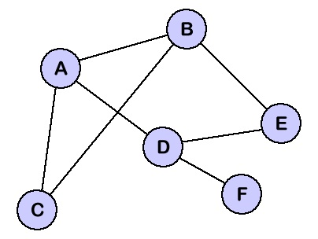
Jargon: Graph versus Chart versus Plot versus Figure
All are referred to as {graph, chart, plot, figure}

Slide 35
Why add graphs if tables are equivalent?
A
H
 | A | B | C | D | E | F | G | H | J | K | M
A | 0 | 1 | 0 | 0 | 0 | 0 | 0 | 0 | 0 | 0 | 0
B | 1 | 0 | 0 | 0 | 0 | 0 | 0 | 0 | 0 | 0 | 0
C | 0 | 0 | 0 | 0 | 1 | 0 | 1 | 0 | 0 | 0 | 0
D | 0 | 0 | 0 | 0 | 0 | 0 | 0 | 1 | 0 | 0 | 0
E | 0 | 0 | 1 | 0 | 0 | 0 | 0 | 0 | 0 | 1 | 0
F | 0 | 0 | 0 | 0 | 0 | 0 | 0 | 0 | 0 | 0 | 1
G | 0 | 0 | 1 | 0 | 0 | 0 | 0 | 1 | 0 | 1 | 0
H | 0 | 0 | 0 | 1 | 0 | 0 | 1 | 0 | 0 | 0 | 0
J | 0 | 0 | 0 | 0 | 0 | 0 | 0 | 0 | 0 | 1 | 0
K | 0 | 0 | 0 | 0 | 1 | 0 | 1 | 0 | 1 | 0 | 0
M | 0 | 0 | 0 | 0 | 0 | 1 | 0 | 0 | 0 | 0 | 0
J
B
G
C
K
F
D
E
M

Slide 36
Use graphs when focused on relations among entitites
Benefits:
Different way of thinking about the problem
Useful for questions where relations are complex
Defining all values (ie in a table) is not required
Potentially more efficient representation when compared to a table
Representation is intuititive
Makes pretty pictures

Slide 37
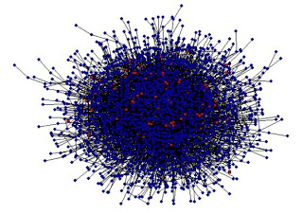
Costs
Requires different algorithms (compared to table-based data)
Learning
Visual Rendering of large graphs is slow
Visual rendering of large graphs is useless: "hairball"

Slide 38
Use cases for graphs
Fraud detection for banking and for credit card transactions
https://towardsdatascience.com/getting-started-with-graph-analysis-in-python-with-pandas-and-networkx-5e2d2f82f18e
Logistics
https://www.analyticsvidhya.com/blog/2018/04/introduction-to-graph-theory-network-analysis-python-codes/
Natural Language Processing
https://medium.com/@aneesha/beyond-bag-of-words-using-pytextrank-to-find-phrases-and-summarize-text-f736fa3773c5
Notes:
https://ocw.mit.edu/courses/electrical-engineering-and-computer-science/6-864-advanced-natural-language-processing-fall-2005/lecture-notes/lec18.pdf
https://medium.com/@aneesha/beyond-bag-of-words-using-pytextrank-to-find-phrases-and-summarize-text-f736fa3773c5

Slide 39
Social Network Analysis applied in advertising
Companies sell graph database of consumers
https://www.faraday.io/technology/faraday-identity-graph
How the graph gets used by advertisers:
https://blog.liveintent.com/identity-graphs-power-the-next-era-of-marketing/
https://www.signal.co/blog/6-things-about-id-graphs/
https://www.zdnet.com/article/microsoft-touts-linkedin-graph-api-and-ai-foundations-of-its-new-bing-ad-service/

Slide 40
Relations and Layout are unrelated
A
H
J
F
D
B
G
J
C
K
M
F
A
H
E
B
D
M
K
G
E
Positions of nodes is irrelevant
Length of edges is irrelevant
C

Slide 41
Static Visualization of Graphs
Graphviz is a stand-alone graph rendering tool with a domain specific language, "dot," for describing graphs
http://www.graphviz.org/
There's a Python module:
https://pypi.org/project/graphviz/
Demo:
http://127.0.0.1:8888/notebooks/week12_property_graph/graphviz_for_static_graph_visualization.ipynb

Slide 42


Slide 43
Objective of this quiz is to evaluate your understanding of how well you understand relation between graph and adjacency matrix
In addition to this one, there are four more of these quizzes coming

Slide 44
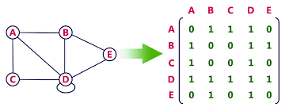

Vote for the missing entry in the table

Slide 45
Answer for the missing entry in the table

Slide 46
Explanation for the missing entry in the table
Use symmetry of adjacency matrix to identify missing value

Slide 47
Activity: Partner check-in
Count of by 1,2,3,4,5,6,7,1,2,3,4,5,6,7
Find your partner who has the same number

Slide 48
Activity: Partner check-in
Count of by 1,2,3,4,5,6,7,1,2,3,4,5,6,7
Find your partner who has the same number
Summarize the content covered in this session so far

Slide 49
Another Python package for graphs: networkx
Demo
http://127.0.0.1:8888/notebooks/week12_property_graph/networkx.ipynb
https://en.wikipedia.org/wiki/Six_Degrees_of_Kevin_Bacon
https://en.wikipedia.org/wiki/Shortest_path_problem#Undirected_graph
https://en.wikipedia.org/wiki/Floyd%E2%80%93Warshall_algorithm
https://networkx.github.io/documentation/stable/reference/algorithms/shortest_paths.html

Slide 50
Directed Graphs
Addressing points from week 11
Introduction to Graphs
Directed Graphs

Slide 51
Directed Graph: edges with direction
A
H
J
B
Edges can be
Directionless
single direction
both directions
What is "correct" depends on what the graph is describing
G
C
K
F
D
E
M
Notes:
https://stackoverflow.com/questions/20133479/how-to-draw-directed-graphs-using-networkx-in-python

Slide 52
Example application of directed graph
Folders and files
http://localhost:8888/lab
Pycallgraph
Folders and files
Website links
https://scrapethissite.com/faq/
http://toscrape.com/

Slide 53
Use case for a graph of web links
https://en.wikipedia.org/wiki/PageRank

Slide 54
Relation between table and directed graph
Destination node (to)
A
H
 | A | B | C | D | E | F | G | H | J | K | M
A | 0 | 1 | 0 | 0 | 0 | 0 | 0 | 0 | 0 | 0 | 0
B | 0 | 0 | 0 | 0 | 0 | 0 | 0 | 0 | 0 | 0 | 0
C | 0 | 0 | 0 | 0 | 1 | 0 | 0 | 0 | 0 | 0 | 0
D | 0 | 0 | 0 | 0 | 0 | 0 | 0 | 0 | 0 | 0 | 0
E | 0 | 0 | 0 | 0 | 0 | 0 | 0 | 0 | 0 | 1 | 0
F | 0 | 0 | 0 | 0 | 0 | 0 | 0 | 0 | 0 | 0 | 1
G | 0 | 0 | 1 | 0 | 0 | 0 | 0 | 1 | 0 | 0 | 0
H | 0 | 0 | 0 | 1 | 0 | 0 | 0 | 0 | 0 | 0 | 0
J | 0 | 0 | 0 | 0 | 0 | 0 | 0 | 0 | 0 | 1 | 0
K | 0 | 0 | 0 | 0 | 0 | 0 | 1 | 0 | 1 | 0 | 0
M | 0 | 0 | 0 | 0 | 0 | 0 | 0 | 0 | 0 | 0 | 0
J
B
G
C
K
F
Source
Node
(From)
D
E
M
Sanity check: Number of entries with "1" should equal number of arrow heads

Slide 55
Vote for the missing entry in the adjacency matrix

Slide 56
Objective of this quiz is to evaluate your understanding of how well you understand relation between directed graph and adjacency matrix
Quizzes 2 and 3 of 4

Slide 57
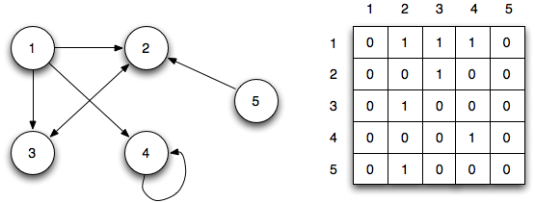
Vote for the missing entry in the table
Source: http://faculty.ycp.edu/~dbabcock/PastCourses/cs360/lectures/lecture15.html
Notes:
http://faculty.ycp.edu/~dbabcock/PastCourses/cs360/lectures/lecture15.html

Slide 58
Answer for the missing entry in the table
Source: http://faculty.ycp.edu/~dbabcock/PastCourses/cs360/lectures/lecture15.html
Notes:
http://faculty.ycp.edu/~dbabcock/PastCourses/cs360/lectures/lecture15.html

Slide 59
Explanation for the missing entry in the table
Directed graphs are not symmetric
1 --> 2 and 1 --> 3 and 1 --> 4; first row captures that
Nothing goes to 1
To
From
Source: http://faculty.ycp.edu/~dbabcock/PastCourses/cs360/lectures/lecture15.html
Notes:
http://faculty.ycp.edu/~dbabcock/PastCourses/cs360/lectures/lecture15.html

Slide 60
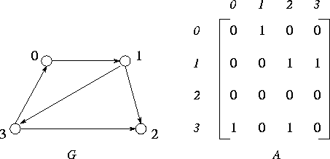
Vote for the missing entry in the table
Notes:
https://www.mcs.anl.gov/~itf/dbpp/text/node35.html

Slide 61
To
Answer for missing entry in the table
Directed graphs are not symmetric
1 --> 2 and 3 --> 2; column "2" captures that
From 3 to 0 means the lower-left value is 1
From
Notes:
https://www.mcs.anl.gov/~itf/dbpp/text/node35.html

Slide 62
Activity: Elevator pitch

Slide 63
How Ben uses short exposure to leaders
Where: hallway encounters
Leader's exposure to low-level truth is limited
[Good] leaders don't want to micromanage
What does leadership expect to hear?
Not enough resources (people, money, time, computers, data)
Everything is going great
I will get that report to you by Thursday

Slide 64
How Ben uses short exposure to leaders
Can I describe something novel?
What are you planning to do next?
Rumors need to be vetted before sharing
Duplicative efforts with other teams
No one likes delivering bad news
(Project) is going to be late
(Project) is unlikely to succeed
--> This is the ground truth leaders want
Mid-level managers dislike delivering bad news to leaders

Slide 65
Activity: elevator pitch
Step 1 of 3
Form groups of 3 by counting off: 1, 2, 3, 4, 5, 1, 2, 3, 4, 5, 1, 2, 3, 4, 5

Slide 66
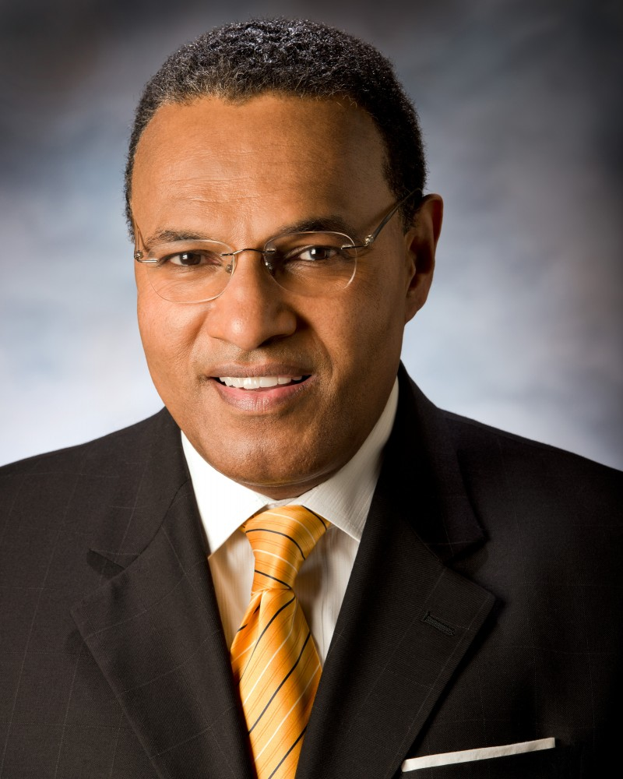
Activity: develop an elevator pitch
Step 2 of 3
Situation: You see Freeman Hrabowski
(President of UMBC) walking towards
the UMBC library.
Explain what you are learning about
data science and what you plan to use
your skills for

Slide 67
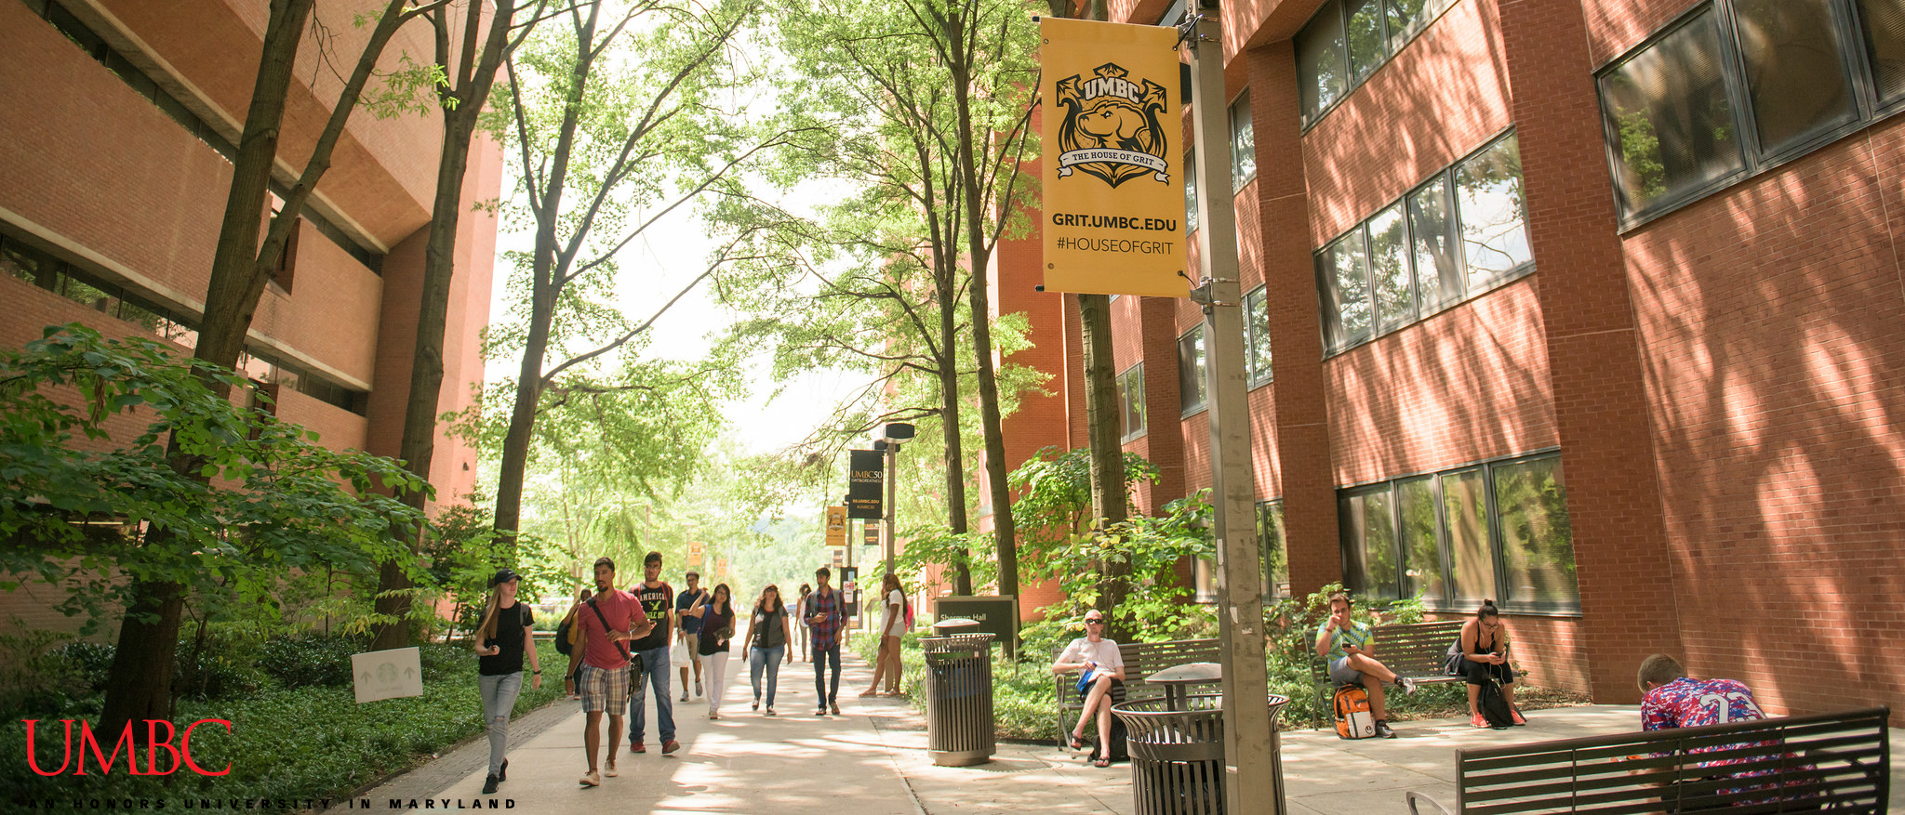
Activity: present your elevator pitch
Step 3 of 3

Slide 68
Weighted Graphs
Addressing points from week 11
Introduction to Graphs
Directed Graphs
Weighted Graphs

Slide 69
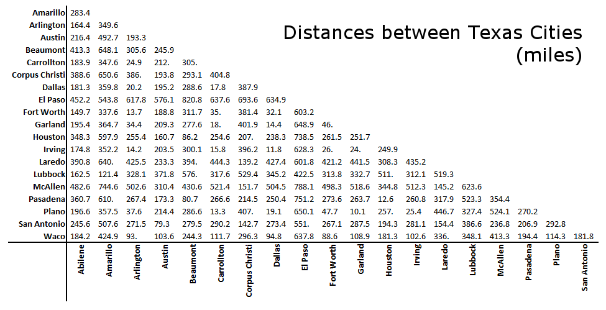
Example applications of weighted graph
Travelling salesperson problem: "Given a list of cities and the distances between each pair of cities, what is the shortest possible route that visits each city and returns to the origin city?"
source
Notes:
https://www.ultra-mileage.com/tools.php
https://www.datacamp.com/community/tutorials/networkx-python-graph-tutorial

Slide 70
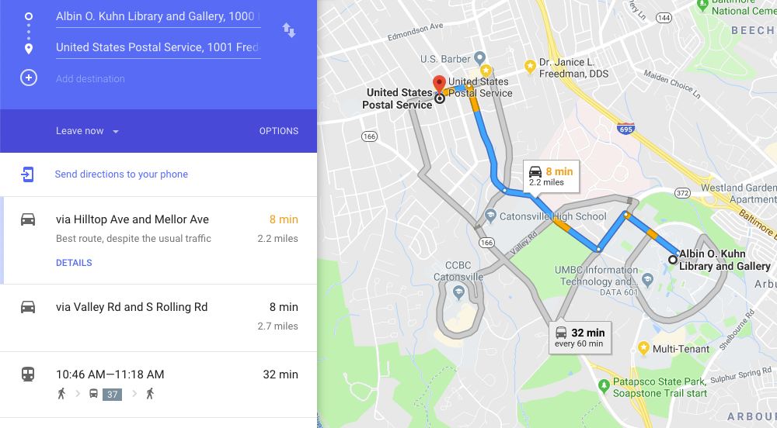
https://blogs.cornell.edu/info2040/2011/09/14/google-maps-its-just-one-big-graph/
https://motherboard.vice.com/en_us/article/4x3pp9/the-simple-elegant-algorithm-that-makes-google-maps-possible
Notes:
https://www.avglab.com/andrew/PDF/hd-jour.pdf
https://www.avglab.com/andrew/PDF/hi-dim.pdf

Slide 71
weighted graph and adjacency matrix
A
H
 | A | B | C | D | E | F | G | H | J | K | M
A | 0 | 4 | 0 | 0 | 0 | 0 | 0 | 0 | 0 | 0 | 0
B | 4 | 0 | 0 | 0 | 0 | 0 | 0 | 0 | 0 | 0 | 0
C | 0 | 0 | 0 | 0 | 4 | 0 | 2 | 0 | 0 | 0 | 0
D | 0 | 0 | 0 | 0 | 0 | 0 | 0 | 2 | 0 | 0 | 0
E | 0 | 0 | 4 | 0 | 0 | 0 | 0 | 0 | 0 | 4 | 0
F | 0 | 0 | 0 | 0 | 0 | 0 | 0 | 0 | 0 | 0 | 1
G | 0 | 0 | 2 | 0 | 0 | 0 | 0 | 4 | 0 | 4 | 0
H | 0 | 0 | 0 | 2 | 0 | 0 | 4 | 0 | 0 | 0 | 0
J | 0 | 0 | 0 | 0 | 0 | 0 | 0 | 0 | 0 | 1 | 0
K | 0 | 0 | 0 | 0 | 4 | 0 | 4 | 0 | 1 | 0 | 0
M | 0 | 0 | 0 | 0 | 0 | 1 | 0 | 0 | 0 | 0 | 0
J
B
G
C
K
F
D
E
M

Slide 72
Directed weighted graph and adjacency matrix
A
H
 | A | B | C | D | E | F | G | H | J | K | M
A | 0 | 4 | 0 | 0 | 0 | 0 | 0 | 0 | 0 | 0 | 0
B | 4 | 0 | 0 | 0 | 0 | 0 | 0 | 0 | 0 | 0 | 0
C | 0 | 0 | 0 | 0 | 4 | 0 | 2 | 0 | 0 | 0 | 0
D | 0 | 0 | 0 | 0 | 0 | 0 | 0 | 2 | 0 | 0 | 0
E | 0 | 0 | 4 | 0 | 0 | 0 | 0 | 0 | 0 | 4 | 0
F | 0 | 0 | 0 | 0 | 0 | 0 | 0 | 0 | 0 | 0 | 1
G | 0 | 0 | 2 | 0 | 0 | 0 | 0 | 4 | 0 | 4 | 0
H | 0 | 0 | 0 | 2 | 0 | 0 | 4 | 0 | 0 | 0 | 0
J | 0 | 0 | 0 | 0 | 0 | 0 | 0 | 0 | 0 | 1 | 0
K | 0 | 0 | 0 | 0 | 4 | 0 | 4 | 0 | 1 | 0 | 0
M | 0 | 0 | 0 | 0 | 0 | 1 | 0 | 0 | 0 | 0 | 0
J
B
G
C
K
F
D
E
M

Slide 73
Example application of Weighted directed graphs
Social interactions, ie dating
https://globaldatinginsights.com/2015/08/18/18082015-how-dating-sites-match-singles-up-using-advanced-graphs/
https://linkurio.us/blog/recommendation-and-graphs-an-online-dating-use-case/

Slide 74
Vote for the missing entry in the table

Slide 75
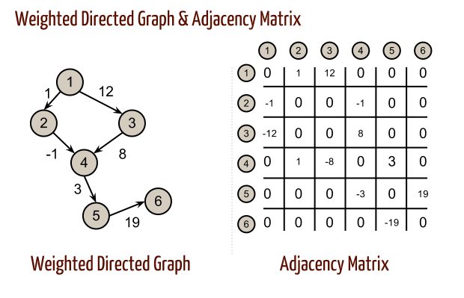

Slide 76
No direct
connection between 2 and 5

Slide 77
Standard problems when using graphs
Fully connected graph has little value
Visualization may not add value
Visualization can be computationally expensive for large graphs
Visualization can be slow to render for large graphs

Slide 78
Graph software
https://cytoscape.org/

Slide 79
Data sources
https://networkdata.ics.uci.edu/

Slide 80
Property Graphs

Slide 81
Property graph = graph + attributes
Let a node represent a person
An edge is a relationship between people
Person:Ben is_friend_of(duration_years:3) Person:Mary
Person:Ben is_friend_of(duration_years:1) Person:Alex
Person:Ben(born_year:1923)
Person:Mary(born_year:1958)
Person:Alex(born_year:1982)

Slide 82
Neo4j
Domain Specific Language: CYPHER
Open source (free) and paid versions
Web interface for queries and visualization
Use py2neo for Python interaction

Slide 83
Alternative to Neo4j: OrientDB
https://en.wikipedia.org/wiki/OrientDB
https://orientdb.com/
docker run -d --name orientdb -p 2424:2424 -p 2480:2480 -e ORIENTDB_ROOT_PASSWORD=rootpwd orientdb
http://localhost:2480/studio/index.html#/

Slide 84
Neo4j web interface
docker run --publish=7474:7474 --publish=7687:7687 --volume=$HOME/neo4j/data:/data --env=NEO4J_AUTH=none neo4j
In your web browser, go to
http://localhost:7474/

Slide 85
Demo of Neo4j in browser interface
CREATE (mom:Person { first_name: 'Sally', middle_name: 'BreadEater', last_name: 'Smith', born_on_date: 19920521, born_in_city: 'Westboro', born_in_state: 'Happiness' }) CREATE (dad:Person { first_name: 'Bob', middle_name: 'JamMaker', last_name: 'Brown', born_on_date: 19910323, born_in_city: 'Middleton' }) CREATE (mom)-[:married { on_date: 20130221 }]->(dad) CREATE (sis1:Person { first_name: 'Mary', middle_name: 'Butter', last_name: 'Middleton', born_on_date: 20150612, born_in_city: 'Edgerville' }) CREATE (sis1)-[: biologicalChildOf { on_date: 20130221 }]->(mom) CREATE (sis1)-[: biologicalChildOf { on_date: 20130221 }]->(dad) CREATE (puncl1:Person { first_name: 'Rob', middle_name: 'JellyMaker', last_name: 'Brown', born_on_date: 19891130, born_in_city: 'Middleton' }) CREATE (pgranfather1:Person { first_name: 'Robert', middle_name: 'Grape', last_name: 'Brown', buried_in_city: 'Boringville', buried_in_cemetery: 'Plotstown', buried_coordinates: '37.595677, -87.446520', born_on_date: 19700110, born_in_city: 'Middleton' })
CREATE (puncl1)-[: biologicalChildOf { on_date: 20130221 }]->(pgranfather1)
CREATE (dad)-[: biologicalChildOf { on_date: 20130221 }]->(pgranfather1)
http://localhost:7474/browser/
To view the graph,
MATCH (n) RETURN n limit 100
Notes:
https://graphthinking.blogspot.com/2018/07/family-tree-in-neo4j.html

Slide 86
Connect to Neo4j using Py2neo
docker network create -d bridge --subnet 192.168.0.0/24 --gateway 192.168.0.1 dockernet

Slide 87
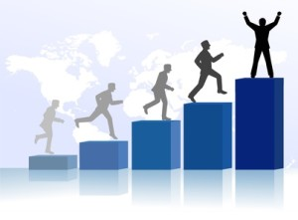
Suppose you have a successful career

Slide 88

Suppose you have a successful career
You want to help your family members be successful
So you help them get a job at your workplace

Slide 89
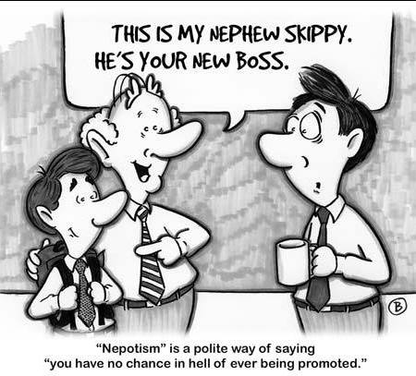
Nepotism
https://en.wikipedia.org/wiki/Nepotism = favour granted to relatives

Slide 90
Example using Fake data
Generate families
Generate workplace relationships using same people
Detect nepotism

Slide 91
Getting data out of Neo4j
https://stackoverflow.com/questions/25567744/backup-neo4j-community-edition-offline-in-unix-mac-or-linux/25569005#25569005 https://stackoverflow.com/questions/38381570/how-to-save-graphs-in-neo4j https://neo4j.com/developer/kb/export-sub-graph-to-cypher-and-import/ neo4j-admin dump/load https://neo4j.com/docs/operations-manual/current/tools/dump-load/

Slide 92
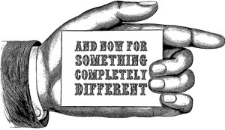
<<<Context switch>>>

Slide 93
Opportunity
"How to Improve Anti-Money Laundering Investigation using Neo4j"
December 6th, 2018 10:00 a.m. Eastern
Learn how to use Neo4j and the power of connected data along with graph analytics techniques to improve anti-money laundering investigations and compliance. Neo4j employees will demonstrate how Neo4j enables faster and more accurate AML investigations, even across diverse and siloed data landscapes.
https://go.neo4j.com/181206-register.html
More webinars: http://message.neo4j.com/v00m0NeO0Y1CRA5gR02J000

Slide 94
Graphs and Machine Learning
The nodes, node attributes, edges, and edge attributes are not always provided in a dataset
Machine Learning can be used to predict missing edges and other information needed
Large graphs have more features to base the training on
https://towardsdatascience.com/graph-representation-learning-dd64106c9763

Slide 95
LinkedIn
You can leverage the connections you've made in this class!
www.linkedin.com/in/ben-is-located

Slide 96
Homework

Slide 97
Activity: Know/Don't know/Want to know
On a paper that you will turn in to Ben prior to departing, write down
1 thing you already knew that was covered in this session
1 thing covered in this session you didn't previously know
1 thing you wanted to know but wasn't covered in this session

Slide 98
Task: install Docker Community Edition (CE) stable
https://www.google.com/search?q=docker+install
The software is free
https://docs.docker.com/install/
https://docs.docker.com/docker-for-windows/install/
https://www.youtube.com/results?search_query=docker+windows+installation
https://docs.docker.com/docker-for-mac/install/
https://www.youtube.com/results?search_query=docker+mac+installation

Slide 99
How to validate Installation of Docker
https://docs.docker.com/get-started/
docker –version
docker run hello-world

Slide 100
Reading assignment --> Quiz on Blackboard
"Mining massive datasets"
page 163 to 168 (181 to 186 in the PDF)
plus the summary of chapter 5 on page 196-197 (214 to 215)

Slide 101
Homework:
Given an initial directory location on your computer, and
Given Python code for listing files and folders in that location, and
Given Graphviz code that can produce a directed graph,
Produce a visualization of the directed graph that shows all files and folders in the initial location.
from os import walk
path ="." # current directory
for (dirpath, dirnames, filenames) in walk(path):
print('current location:',dirpath)
print('folders: ',dirnames)
print('files: ',filenames,'\n')

Slide 102
Homework assignment: parse .ipynb files
Create a notebook that finds all other notebooks used for Data 601 on your computer and generates a list of the modules used
Lines of code that start with either "from" or "import"
Submit your python notebook (.ipynb file) containing the code for the implementation and the results. Results are a list of modules used.
Optional bonus question: How many lines of Python code have you created for Data 601?

Slide 103
Breakdown the Homework, Part 1 of 2
Draw or write down what you're starting with
Draw or write down what the outcome should look like

Slide 104
Breakdown the Homework, Part 2 of 2: Design your approach to solving the problem
Given the starting point and end point, what steps are needed?
Write down actions you'll need to take
Determine the dependencies among the actions you need to take
In what order should the steps be?
If you have time before leaving, take the listed actions using your computer

